Slide 1
Preliminary Design Review Group 21 Project #21: Wildlife Refuge

Slide 2

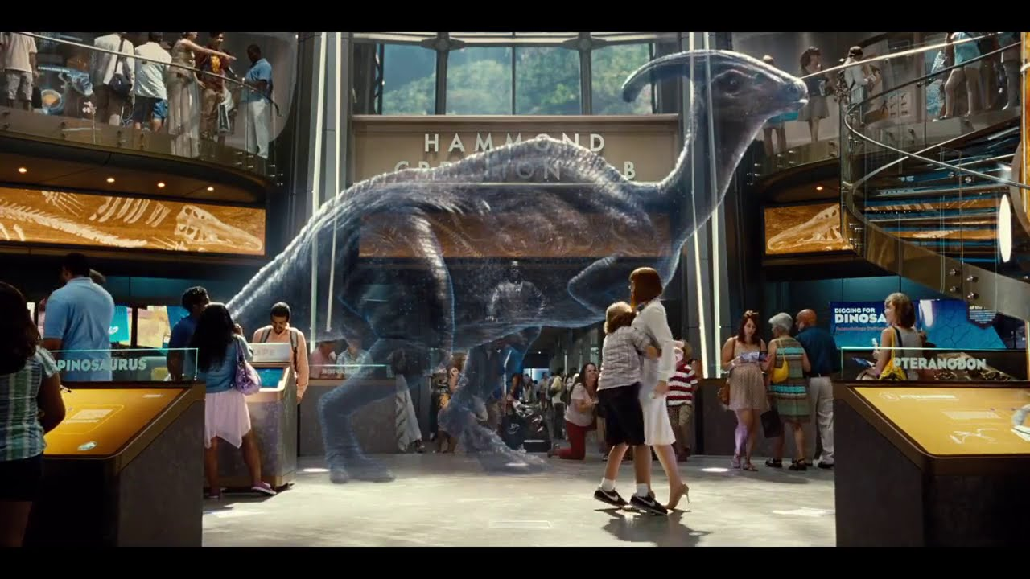
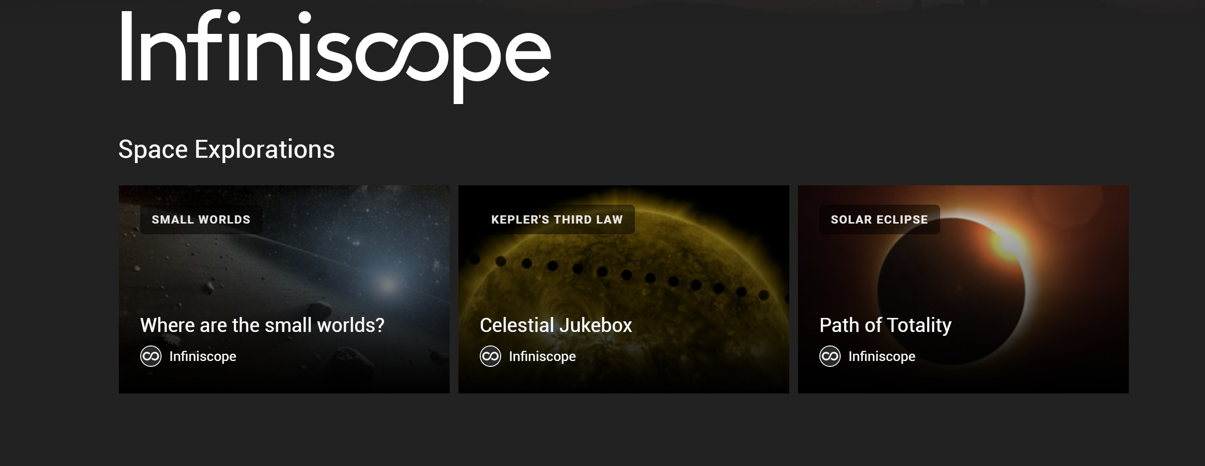
Project Description Jacob Cerda

Slide 3


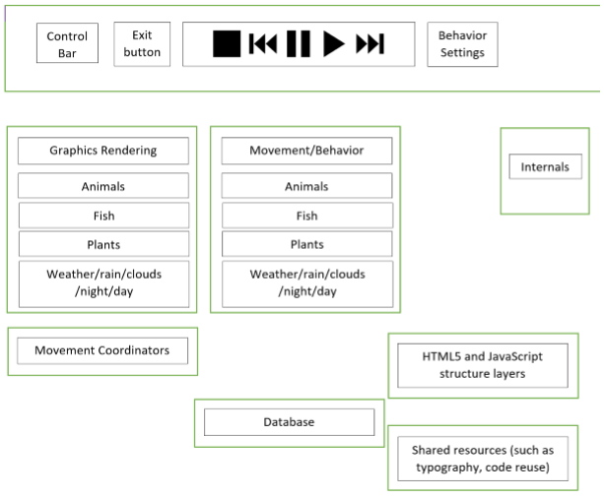
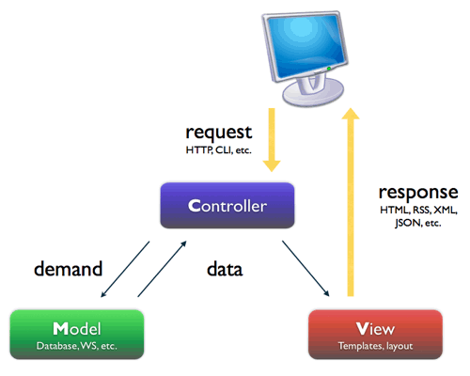




Design and Architecture Enos Franceschini

Slide 4
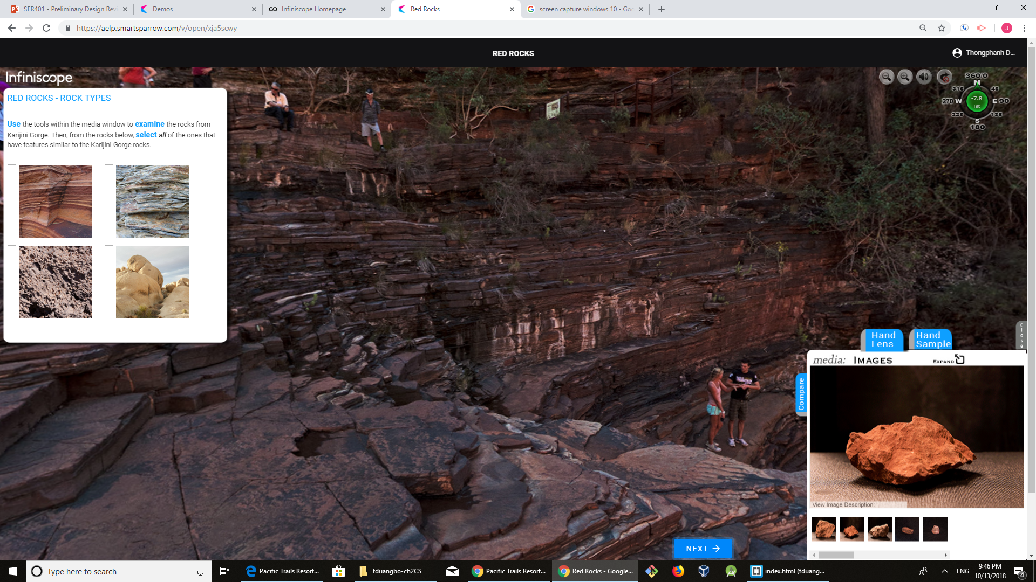
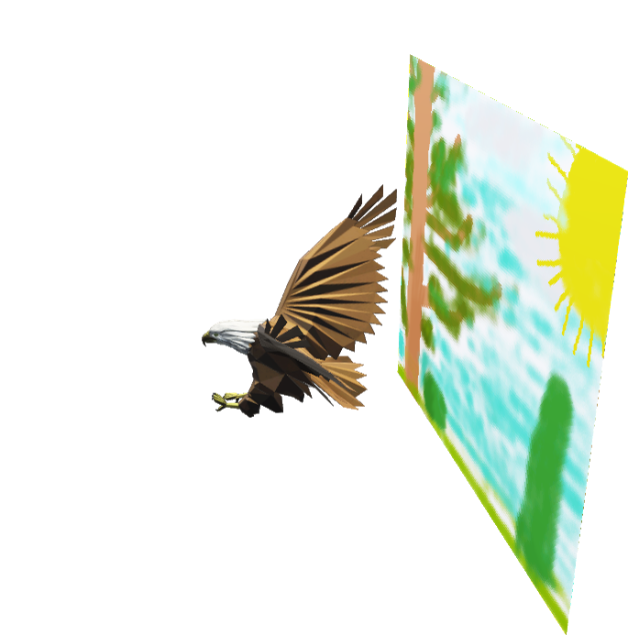
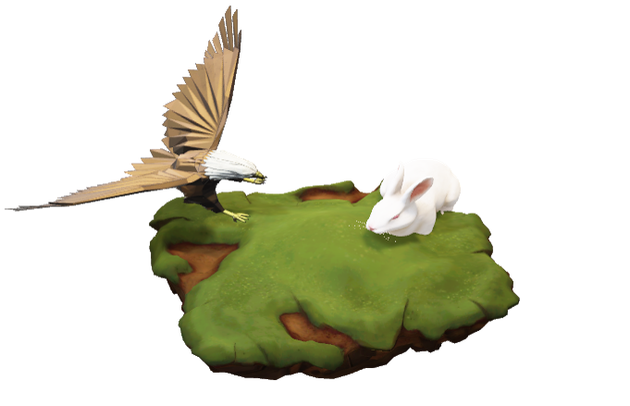
Implementation Strategy Thongphanh Duangboudda
Schedule/Timeline
Sprint1, Sprint2, and Sprint3
Data and Intelligence
High-Level Work Breakdown Structure
HTML, JavaScript, and Web Graphics Library
SmartSparrow Learning Platform

Slide 5



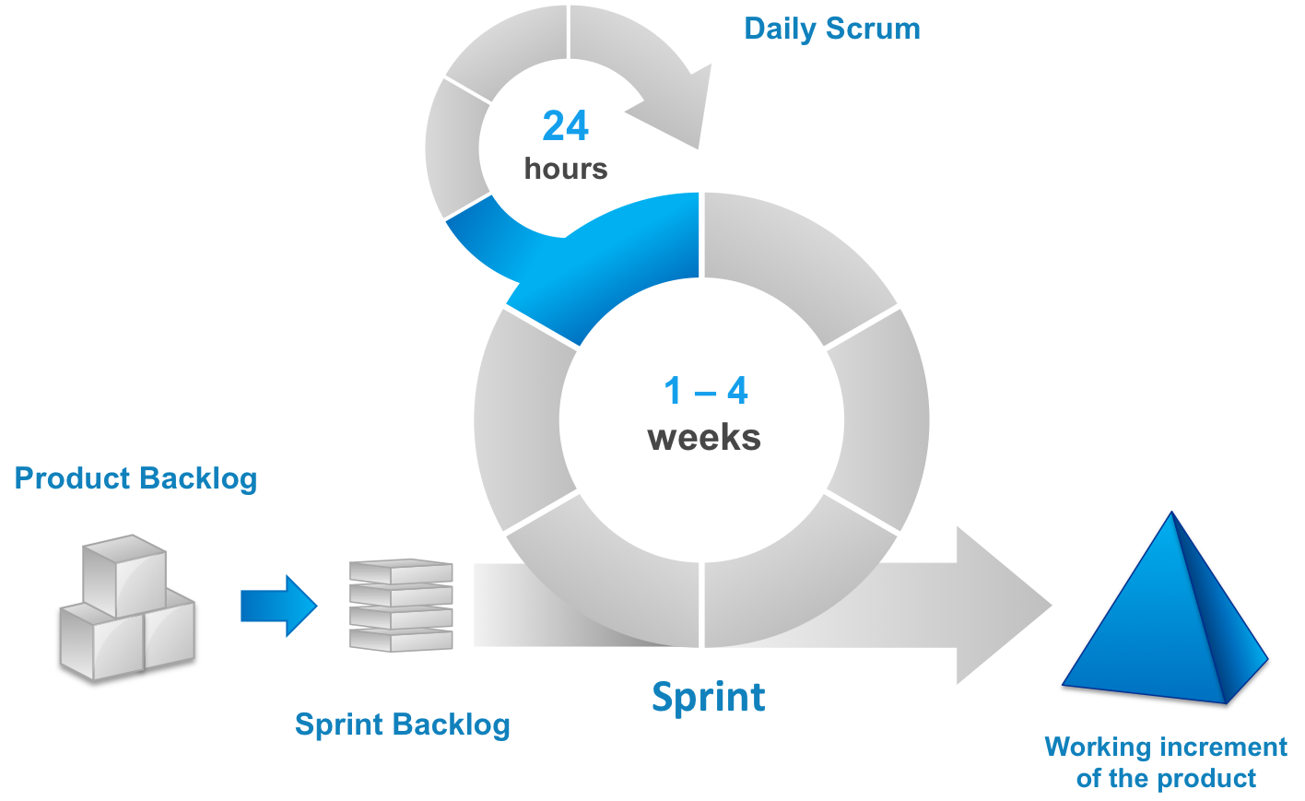





Process Enos Franceschini
Source commits
Code Reviews Rotating Roles
3 Weeks Rotating Roles
Sprints User Stories Tasks
SRS MTP Project Plan Minutes
Stand-ups
Sponsor Meetings
Publish Changes
Test Site
Continuous Integration

Slide 6
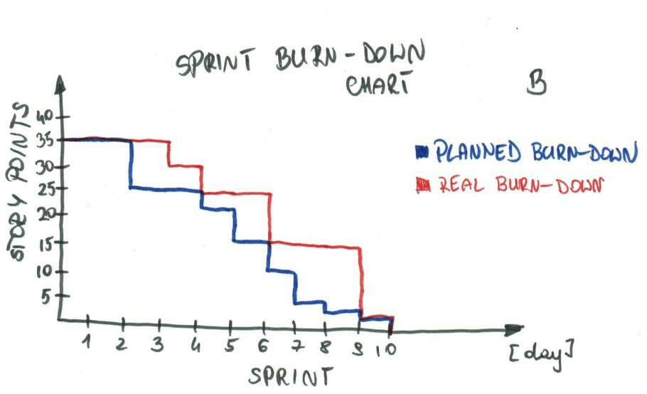
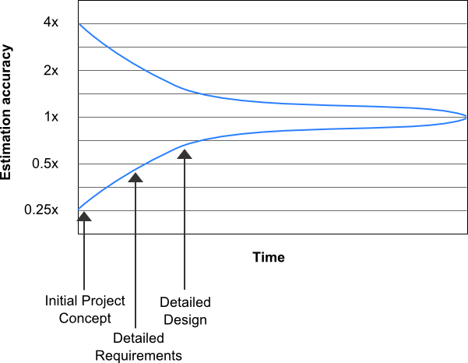
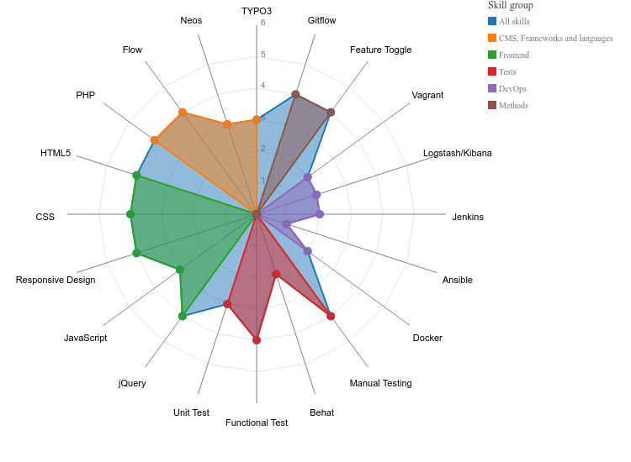
Risk Management Maxwell Heller
Uncertain levels of Project Complexity
Balancing Team Skill Distribution
Quality Standards/Key Metrics

